Slide 1
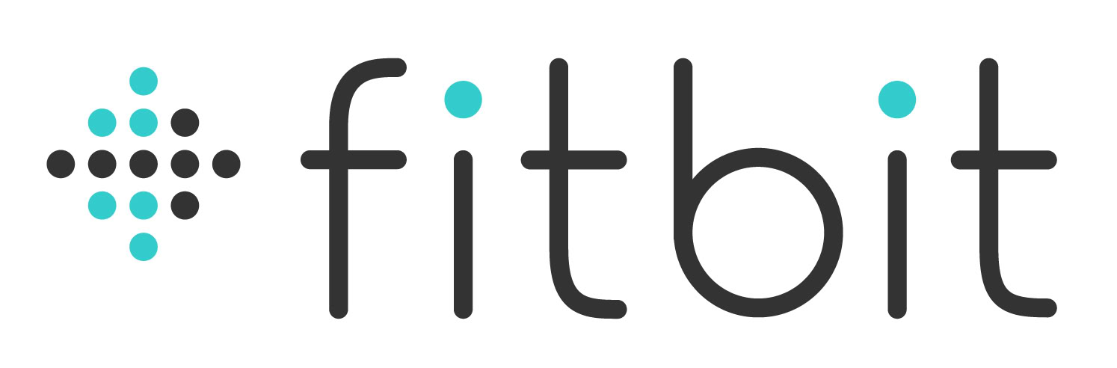
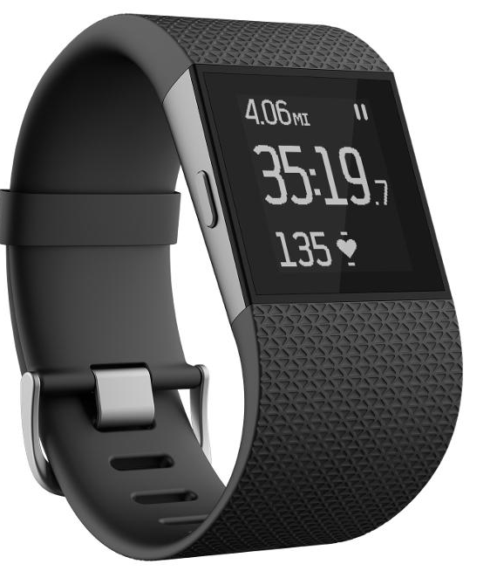

Together
(Smart Training management System)
Charge2
TM
CMPE 272
Professor Rakesh Ranjan
Group 27: Apoorv,Parth,Parvez,Shrey

Slide 2
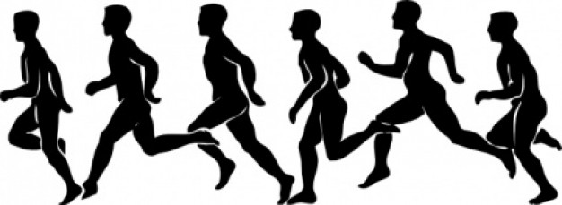
The Idea
What can this application do for you?
Need of Application…
Why Large Teams outperform Small teams?
Coaches can store, analyze and visualize the fitness activity data of their players
Coaches can Track....
Frequency
Intensity
Tenacity
Effectiveness
Advantage....
Minimal investment of just the IOT device cost
Continuous monitoring of the activities of the players
Fast and effective analysis
Continuous feedback
Performance Enhancement
Notes:
The FitBit Surge was developed by FitBit as the ultimate fitness tracker and watch. The release was announced in October 2014 and its target audience consisted of the (obviously) fitness demographic, mostly to those who love running, cycling, or strength training.
But regardless of what you’re doing, the FitBit tracks steps taken, your heart rate, distance traveled, calories burned, floors climbed, and simplified heart rate zones. It also saves your information from prior workouts, so you can actually track progress or what you specifically need to change that’s worked before or hasn’t. You can also turn on custom “Exercise Modes” for activities like walking and hiking, where GPS tracking is automatically activated. These saved exercises can be accessed through your mobile devices as well; FitBit is currently compatible with select iOS, Android, and Windows phones.
The Surge is also water resistant (to a degree). It can handle the “sweatiest workouts” and is rain and splash proof, but FitBit recommends you take it off prior to showering or entering a pool.
Another neat benefit is that it can track your Zzz’s when you wear it to bed! There’s a motion sensor built into the Surge that analyzes whether or not you’re asleep, and can even tell when you’re attempting to sleep, but are restless. It uses this data over time to create summaries of when you sleep the best, or around what time you finally fall asleep, etc. so it can provide you with how to sleep more efficiently in the future!

Slide 3
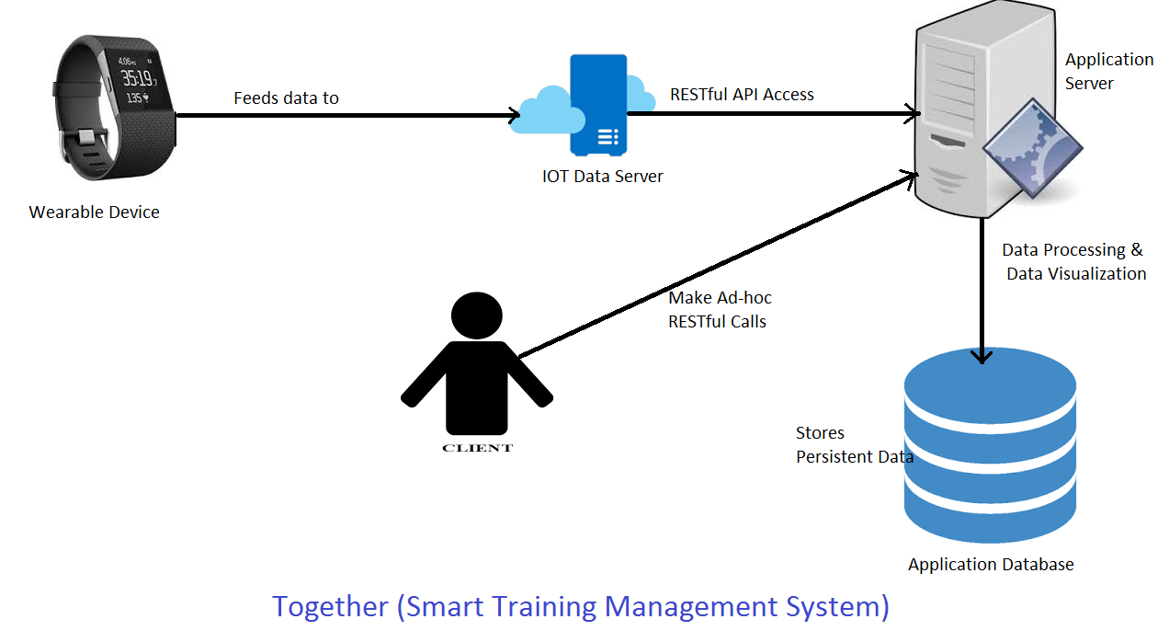
The Architecture
Notes:
The FitBit Surge was developed by FitBit as the ultimate fitness tracker and watch. The release was announced in October 2014 and its target audience consisted of the (obviously) fitness demographic, mostly to those who love running, cycling, or strength training.
But regardless of what you’re doing, the FitBit tracks steps taken, your heart rate, distance traveled, calories burned, floors climbed, and simplified heart rate zones. It also saves your information from prior workouts, so you can actually track progress or what you specifically need to change that’s worked before or hasn’t. You can also turn on custom “Exercise Modes” for activities like walking and hiking, where GPS tracking is automatically activated. These saved exercises can be accessed through your mobile devices as well; FitBit is currently compatible with select iOS, Android, and Windows phones.
The Surge is also water resistant (to a degree). It can handle the “sweatiest workouts” and is rain and splash proof, but FitBit recommends you take it off prior to showering or entering a pool.
Another neat benefit is that it can track your Zzz’s when you wear it to bed! There’s a motion sensor built into the Surge that analyzes whether or not you’re asleep, and can even tell when you’re attempting to sleep, but are restless. It uses this data over time to create summaries of when you sleep the best, or around what time you finally fall asleep, etc. so it can provide you with how to sleep more efficiently in the future!

Slide 4
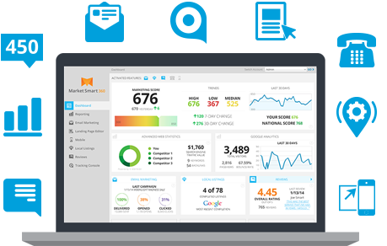
What Is Special?
Monitors frequency ,intencity ,tenacity and effectiveness of all the players
Comparison of all the players’ data by Visualization Graphs using D3.js
The Biggest Advantage
“Performance Enhancement”
Notes:
The FitBit Surge is for anyone who either wants to get into the process of living a more healthy lifestyle or is already living one and wishes to be more aware of his/her progress. From the superior Olympic athlete to the working stay-at-home moms or dads, this device not only provides you with the function of having a watch, but its stylish and tech-savvy face puts an entirely new perspective on an active lifestyle.

Slide 5

Who will be benefited?
Coach
Can regularly Monitor the fitness activities of all the players
Can give Regular feedback to players
Can guide the players to maintain stabilized workflow daily
Players
Wears Fitbit IOT device which monitors daily data of steps,distance,calories,floors
Can improve performance as per the feedback
Notes:
The FitBit Surge is for anyone who either wants to get into the process of living a more healthy lifestyle or is already living one and wishes to be more aware of his/her progress. From the superior Olympic athlete to the working stay-at-home moms or dads, this device not only provides you with the function of having a watch, but its stylish and tech-savvy face puts an entirely new perspective on an active lifestyle.

Slide 6
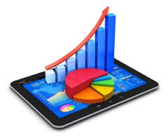

Extending Fitbit
Fitbit
Fitbit API provides data of dalily steps, distance,floors, calories, heartrate etc.
Together
Using Fitbit data to represent frequency, intencity ,tenacity and effectiveness in terms of Graphical Visualization
Notes:
The FitBit Surge is for anyone who either wants to get into the process of living a more healthy lifestyle or is already living one and wishes to be more aware of his/her progress. From the superior Olympic athlete to the working stay-at-home moms or dads, this device not only provides you with the function of having a watch, but its stylish and tech-savvy face puts an entirely new perspective on an active lifestyle.

